Slide 1
The Case for Establishing a Green Revolving Fund (GRF) at Scripps
Isabel Evans (SC '23), Intern for the Sustainability Office

Slide 2
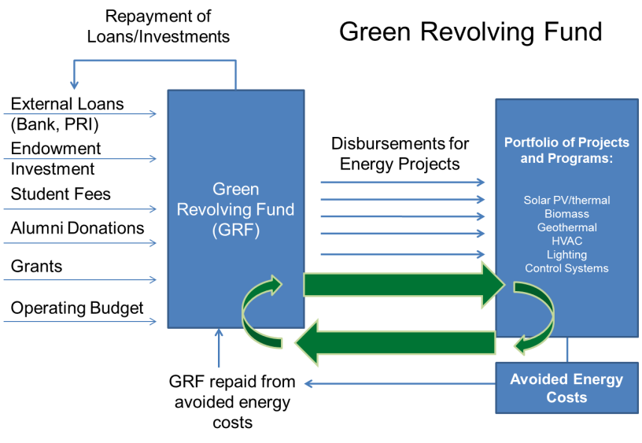
What is a Green Revolving Fund (GRF)?
The Billion Dollar Green Challenge defines a GRF as "an internal fund that provides financing […] to implement energy efficiency, renewable energy, and other sustainability projects that generate cost savings. These savings are tracked and used to replenish the fund for the next round of green investments, thus establishing a sustainable funding cycle"
** While the basic goal of the endowment is to grow in perpetuity, the aim of the GRF is to use funds to finance sustainable projects that also save the college money, rather than locking up funds for later usage.

Slide 3
Projects that could be funded through a GRF
LED retrofits on Tiernan Field and the parking garage
Retrofitting buildings to increase efficiency
Onsite renewables
Increasing water efficiency in landscaping and buildings
Replacing campus fleet vehicles with EVs
Upgrading refrigerators, dishwashers, and other appliances in Malott Commons to more efficient models
Purchasing and operating a bio-digestor to compost food waste on-site
Many others – typically identified and prioritized via energy audit

Slide 4
Benefits of a GRF
Reduce Operating Expenses
  GRFs fund projects that enhance energy and water efficiency, lowering operating expenses and reducing emissions.
    Agnes Scott College achieved a 50% emissions reduction by using their GRF to fund efficiency upgrades, without purchasing carbon offsets.
Return on Investment
  Established GRFs report a median annual ROI of 28%, reliably outperforming average endowment investment returns while hedging against rising energy costs
Leverage Savings into Opportunity
  Rather than allowing the savings from these projects to be absorbed into the operating budget, a GRF tracks savings distinctly and directs them into future projects—thus creating a measurable return on investment (ROI)

Slide 5
Benefits of Establishing a GRF at Scripps
A GRF would demonstrate Scripp's commitment to sustainability and operational efficiency
A GRF can be a compelling way for donors to fund sustainability
Having oversight of the GRF can reinvigorate the Sustainability Committee and give them more resources to make concrete movements towards a more sustainable campus
GRFs can help fund deferred maintenance projects
Notes:
President Elizabeth Kiss and her development team at Agnes Scott College raised over $400,000 in seed capital from donors within a few months by pitching their fund’s strong ROI and its potential to turn the campus into a living laboratory for sustainability

Slide 6
Many of our peer institutions, including other colleges in Southern California and historically women's colleges, have established GRFs.
School | Size of Endowment (in 000s) | Endowment Per Student | Size of GRF | In operation since
Cal Tech | 3,805,000 | 1,587,401 | $8 million | 2008
Wellesley | 2,285,397 | 937,022 | $500,000 (goal to expand to $2 million) | 2014
Scripps | 374,862 | 340,165 | -- | --
Occidental | 439,089 | 212,531 | $3.5 million | 2014
Agnes Scott | 204,799 | 199,415 | $1 million | 2011
La Verne | 113,400 | 41,800 | $400,000 | 2013
As this chart shows, the size of an institutions GRF does not necessarily correspond with their endowment size.

Slide 7
Key Takeaways from Interviews with Peer Institutions
Projected savings can be used determine the payback schedule:
  Projected savings (especially for energy projects) can be calculated with high precision
  During a pilot period for the GRF, start funding smaller projects and use them to verify the accuracy of projected savings against the actual savings
  Using projected saving saves staff labor required to verifying savings
Initially prioritize projects that have a high ROI and that are highly visible to create momentum for the fund

Slide 8
More Key Takeaways
The GRF can begin funding projects on a small-scale before the college has met its fundraising goal for the initial investment
The GRF can be treated like stock portfolio, in which factors can be added to adjust payback periods
The GRITS system is a great place to get ideas of projects and saving potential. All projects in the GRITS system are available to member institutions for review.
A minimum balance does not have to be kept in the fund because the fund will replenish itself with captured savings.

Slide 9
Where does the money for the initial investment (zero-year investment) in the GRF come from?
Potential funding sources:
Funding sources we believe would best suit Scripps:
  Major donors (ex: Agnes Scott)
  Grants (ex: Anges Scott)
  Unused funds from the operating budget
  (ex: La Verne)
  Endowment (ex: Occidental)
  Student Fees (ex: Occidental, Caltech, UC Irvine)
  Startup Funding: Endowment
  Donor Campaign
  Student Fees / SAS

Slide 10
About the donor-based approach
GRF is appealing to donors because:
Strategies for the donor-based approach from Agnes Scott:
        Partner closely with Institutional Advancement to identify potential donors for the seed fund
        Primarily focus on courting major donors who have previously donated to the college and have demonstrated interest in sustainability
        The GRF presents a unique opportunity for donors to contribute to a self-replenishing fund.
        Their entire donations can be used immediately to fund projects (unlike if they were endowed)
Advantages to the donor-based approach:
Disadvantages to the donor-based approach:
        Can supplement the initial investment from endowment and continue to grow the GRF over time
        Can foster an engaged community of sustainability-minded donors, which increases their commitment to the institution by appealing to their values
        It may take time to identify major donors and develop a strong fundraising campaign

Slide 11
Project Eligibility Requirements
Suggested criteria for rubric used to assess proposed projects:
  Implementation cost
  Return on Investment (ROI)
  Projected payback period (in years)
  Projected savings after payback period (How does this project continue to benefit the college after it has paid back its loan?)
  Environmental benefits
  Does this project enable Scripps to meet its climate commitments or commitments to sustainability?
  Visibility on campus
  Opportunities for student engagement
  Opportuniities for curriculum integration
Financial factors
Environmental factors
Intangible factors

