Slide 1
Sustainability Committee
Scripps promotes awareness of our roles and responsibilities for human rights and the sustainability of life on this planet.
The Committee shall seek to educate and encourage students, faculty and staff to advocate for the behavioral and social changes necessary to improve the environmental health of our community and our world.

Slide 2
Agenda
T EM P L A T E D ES I G N 3
Review objectives + committee recommendations
Items highlighted – take vote
Review Case Statement and Vision

Slide 3
In Progress: Develop Case Statement for IA (if donor opportunity should arise)
Proposed: SAS/Business Affairs Match
FUNDING/
RESOURCING
Propose: Revolve Energy Savings (PV, lighting retrofits)
Propose: Add Sustainability to Donations Dropdown Menu
Planned: collab with Pomona + CMC to apply for Pro Bono Consulting through Second Nature
Propose: Fund a summer research intern to help with 2021-22 Annual Report

Slide 4
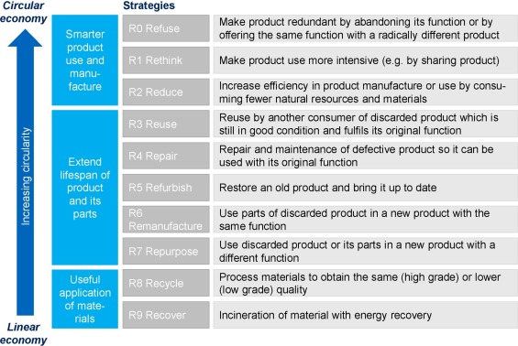
In Progress: Pilot Food Waste Collection at dining hall
(challenge: limited to 6 bins)
Scripps Scrapps: Spring collection, Fall sale
WASTE
Discuss: Campus Waste Audit (why, what it involves, when to do it)
Update: e-waste (Cheryl)
Update: reusable service ware at dining hall

Slide 5
Discuss: Energize Colleges Workshop
How can we generate interest?
In Progress: Scripps Presents talk or series on food + sustainability
EVENTS, OUTREACH + COMMUNICATIONS
Proposal: Develop a Green Office/Green Events Certification program for staff
Add our LEED Schow Hall to City of Claremont's page - revisit upcoming 5-year anniversary

Slide 6
Vision Statement: Academics and Engagement
T EM P L A T E D ES I G N 3

Slide 7
Focus areas: Academic Integration and Experiential Learning
Why?
Scripps offers exceptional academic courses on environmental analysis, climate change, and sustainability – yet students do not see the solutions they learn about in class being implemented on campus.
As Assistant Professor of Economics Nicholas Kacher put it, students want to “put the things we do in class into practice”.
We can design experiential learning programs that engage students to design real solutions to on-campus sustainability challenges.
Scripps staff care about sustainability and want to make a difference.
Notes:
Both Pomona and CMC have students working as EcoReps in the residential halls during the school year. Year-round, Pomona has a student dedicated to data collection and reporting (6 hr/week). In the summer, they hire students to help put together the final sustainability report each year.
Build connections with local organizations to explore partnership opportunities and contribute to local community
My prior experience with SEI Climate Corps program and youth leadership/mentorship can inform green career programming
A faculty member has expressed interest in integrating the data analysis component of greenhouse gas reporting into their Fall 2022 class

Slide 8
Focus areas: Academic Integration and Experiential Learning
We envision…
“Pathways” for students to engage with sustainability on different levels throughout their undergraduate career that will have meaningful, long-term impact on their lives after Scripps
Internships
Community fellowships – partner with local organizations, potential for grant funding
A workplace in which sustainability – social and environmental – is inherent in all decision-making. Every job can, and should be, a sustainability job.
Certification programs that provide staff with the tools and training needed to effect positive behavioral change in their workplace.
Staffing needs: 10 hours/week to conduct initial assessments and help train staff to achieve certification
Notes:
Both Pomona and CMC have students working as EcoReps in the residential halls during the school year. Year-round, Pomona has a student dedicated to data collection and reporting (6 hr/week). In the summer, they hire students to help put together the final sustainability report each year.
Build connections with local organizations to explore partnership opportunities and contribute to local community
My prior experience with SEI Climate Corps program and youth leadership/mentorship can inform green career programming
A faculty member has expressed interest in integrating the data analysis component of greenhouse gas reporting into their Fall 2022 class

Slide 9
Projects for Interns
Calculate the carbon footprint of food in the cafeteria so that we know the impact of what we’re eating
Help administer Green Office/Events Certifications (reduce waste in general operations and events)
Annual Reporting
Notes:
Both Pomona and CMC have students working as EcoReps in the residential halls during the school year. Year-round, Pomona has a student dedicated to data collection and reporting (6 hr/week). In the summer, they hire students to help put together the final sustainability report each year.
Build connections with local organizations to explore partnership opportunities and contribute to local community
My prior experience with SEI Climate Corps program and youth leadership/mentorship can inform green career programming
A faculty member has expressed interest in integrating the data analysis component of greenhouse gas reporting into their Fall 2022 class

