Slide 1
Sustainability Committee
Scripps promotes awareness of our roles and responsibilities for human rights and the sustainability of life on this planet.
The Committee shall seek to educate and encourage students, faculty and staff to advocate for the behavioral and social changes necessary to improve the environmental health of our community and our world.

Slide 2
Sustainability Committee within Organizational Hierarchy
The Sustainability Committee directly advises the Treasurer and the President
Status is at the level of PBAC
Notes:
Both Pomona and CMC have students working as EcoReps in the residential halls during the school year. Year-round, Pomona has a student dedicated to data collection and reporting (6 hr/week). In the summer, they hire students to help put together the final sustainability report each year.
Build connections with local organizations to explore partnership opportunities and contribute to local community
My prior experience with SEI Climate Corps program and youth leadership/mentorship can inform green career programming
A faculty member has expressed interest in integrating the data analysis component of greenhouse gas reporting into their Fall 2022 class

Slide 3
Agenda
T EM P L A T E D ES I G N 3
Waste Data
Planned Workshop Series
PBAC submission
Ideas Submitted

Slide 4
Waste Data
T EM P L A T E D ES I G N 3

Slide 5
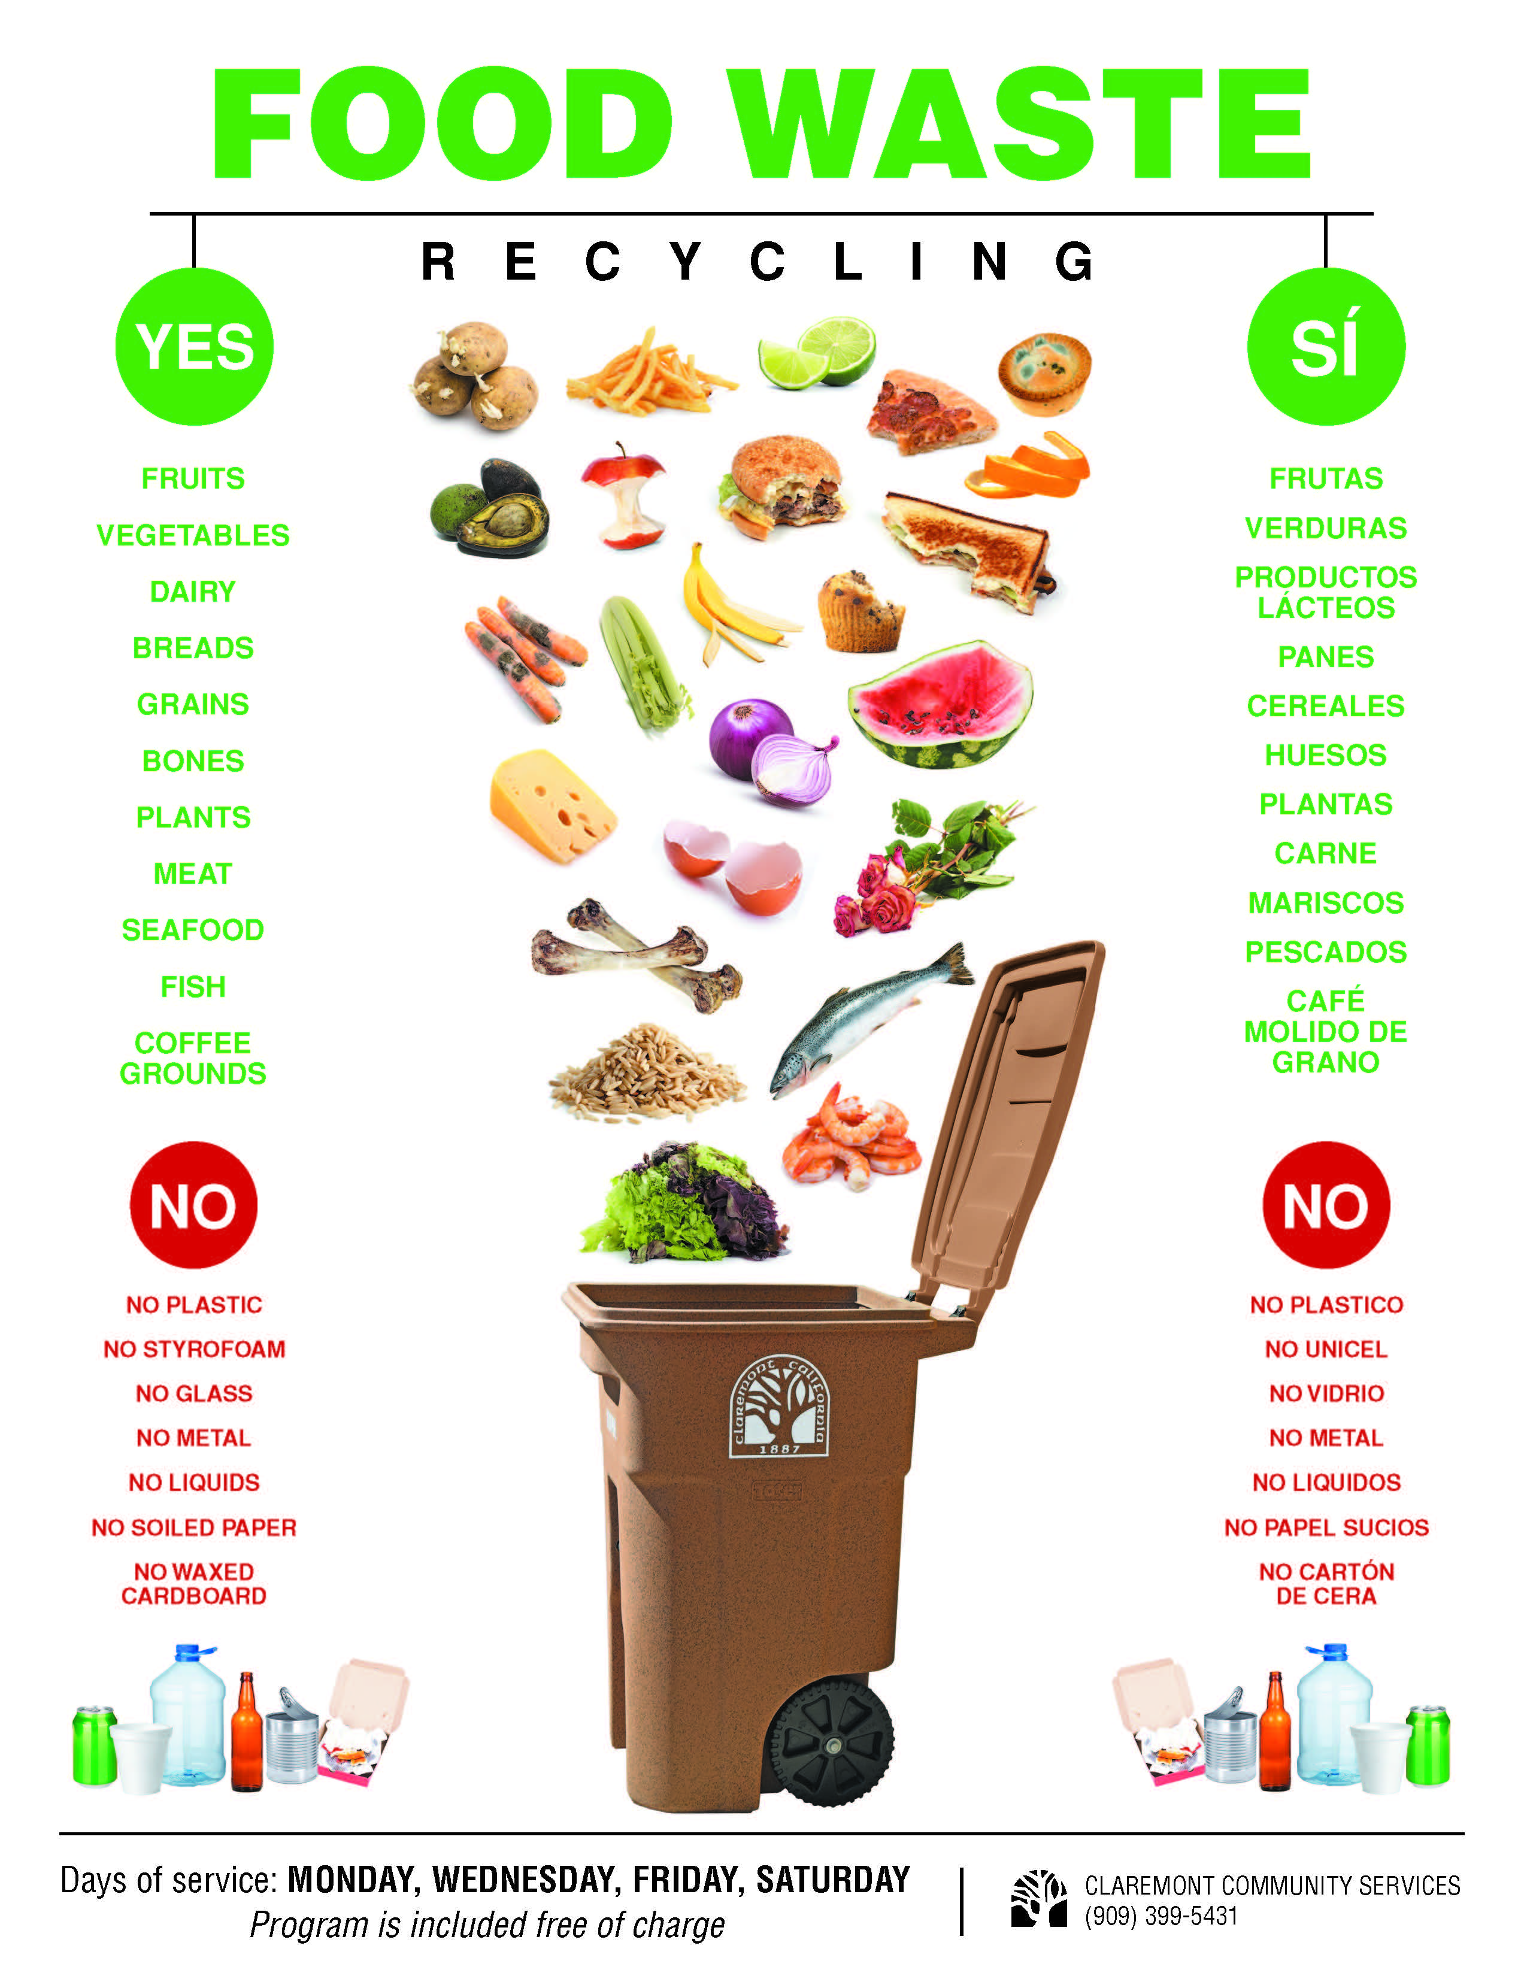
Food Waste
We have 5 bins provided by City of Claremont for food waste
Food waste must be collected in plastic bags
No paper products
Notes:
The SAS student president and sustainability representative reached out to us to schedule a meeting. There is strong student interest in sustainability this year – 11 students formed a sustainability committee and are working on several different topics of interest: composting/waste diversion, the carbon commitment, divestment, Scripps Scrapps and a proposal for a Free Room.
November 5, 8am-12pm
Registration for contact tracing
Open to 5Cs and local community
In 2019, we harvested 1,500 lbs.
Award winning: Los Angeles International Extra Virgin Olive Oil Competition.

Slide 6
This data from City of Claremont:
Trash and green waste numbers are actuals.
Recycle and food waste figures are estimates.
Takeaways:
2019 waste diversion rate was 25%
2017-2018 diversion rate was 35% with programs like Scripps Scrapps, composting, and food recovery.
If we bring these programs back, with no other changes, we could expect about 35% diversion for 2022
Need more data on what is going into trash – potential for waste characterization study
2019
Trash – 231.83 tons
Recycling – Approximately 30 tons
Greenwaste – 39.1 tons
Food Waste – Approximately 6 tons

Slide 7
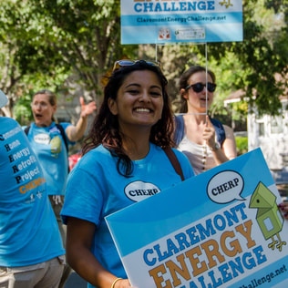
SEI Energize Colleges Partnership
We are looking to host a training series open to student, faculty, and staff in Spring 2022.
This is a great opportunity to engage the campus community in thinking about our energy use. Also potential for academic integration.
Energize Colleges works with higher education institutions to expand or create courses, certificates, and degree programs that integrate energy career training into current academic offerings.
Notes:
Both Pomona and CMC have students working as EcoReps in the residential halls during the school year. Year-round, Pomona has a student dedicated to data collection and reporting (6 hr/week). In the summer, they hire students to help put together the final sustainability report each year.
Build connections with local organizations to explore partnership opportunities and contribute to local community
My prior experience with SEI Climate Corps program and youth leadership/mentorship can inform green career programming
A faculty member has expressed interest in integrating the data analysis component of greenhouse gas reporting into their Fall 2022 class

Slide 8
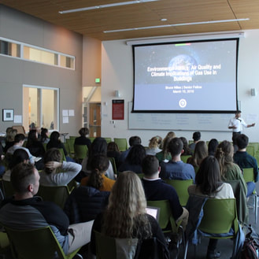
Tentative Program Description
Scripps College would like to host a workshop series, facilitated by SEI, attended by students, faculty, and facilities staff, to analyze newly accessible energy use data, made available by sub-metering each campus building. The goal of the training is to empower this mix of stakeholders to analyze the data, develop campus energy use reduction goals, formulate key strategies, and plan for their implementation. The training will serve to form key relationships between facilities staff, faculty, and students. All stakeholders can collaborate on real-world projects to reduce energy use on campus and effectively use the campus as a living lab.
**Let me know if you are interested in helping plan this workshop series
Notes:
Both Pomona and CMC have students working as EcoReps in the residential halls during the school year. Year-round, Pomona has a student dedicated to data collection and reporting (6 hr/week). In the summer, they hire students to help put together the final sustainability report each year.
Build connections with local organizations to explore partnership opportunities and contribute to local community
My prior experience with SEI Climate Corps program and youth leadership/mentorship can inform green career programming
A faculty member has expressed interest in integrating the data analysis component of greenhouse gas reporting into their Fall 2022 class

Slide 9
Funding Updates
Submitted PBAC Request for:
$2,500 Second Nature Dues (annually)
$10,000 to fund student initiatives ($5,000 per semester)
Notes:
Both Pomona and CMC have students working as EcoReps in the residential halls during the school year. Year-round, Pomona has a student dedicated to data collection and reporting (6 hr/week). In the summer, they hire students to help put together the final sustainability report each year.
Build connections with local organizations to explore partnership opportunities and contribute to local community
My prior experience with SEI Climate Corps program and youth leadership/mentorship can inform green career programming
A faculty member has expressed interest in integrating the data analysis component of greenhouse gas reporting into their Fall 2022 class

Slide 10
Submitted Ideas
T EM P L A T E D ES I G N 3

Slide 11
Waste
Track data on current waste generation, in order to create goals for reducing landfill waste
Reduce food waste by reconnecting Food Recovery Network club with Malott to donate excess food (collab with students)
Reduce waste from single-use items (e.g., utensils, plates, cups, takeout boxes, cereal packs)
Divert food scraps from landfill
Thoughtful planning to reduce waste for events, general operations, and internal/external construction and renovation projects
Notes:
Both Pomona and CMC have students working as EcoReps in the residential halls during the school year. Year-round, Pomona has a student dedicated to data collection and reporting (6 hr/week). In the summer, they hire students to help put together the final sustainability report each year.
Build connections with local organizations to explore partnership opportunities and contribute to local community
My prior experience with SEI Climate Corps program and youth leadership/mentorship can inform green career programming
A faculty member has expressed interest in integrating the data analysis component of greenhouse gas reporting into their Fall 2022 class

Slide 12
Communications
Add our LEED building Schow to the City of Claremont's page and revisiting the upcoming 5-year anniversary
Calculate the carbon footprint of food in the cafeteria so that we know the impact of what we’re eating
Notes:
Both Pomona and CMC have students working as EcoReps in the residential halls during the school year. Year-round, Pomona has a student dedicated to data collection and reporting (6 hr/week). In the summer, they hire students to help put together the final sustainability report each year.
Build connections with local organizations to explore partnership opportunities and contribute to local community
My prior experience with SEI Climate Corps program and youth leadership/mentorship can inform green career programming
A faculty member has expressed interest in integrating the data analysis component of greenhouse gas reporting into their Fall 2022 class

Slide 13
Grounds
Proactively plant for pollinators (communicate existing efforts)
Communicate existing efforts for replacing gas/diesel landscaping equipment with electric
Notes:
Both Pomona and CMC have students working as EcoReps in the residential halls during the school year. Year-round, Pomona has a student dedicated to data collection and reporting (6 hr/week). In the summer, they hire students to help put together the final sustainability report each year.
Build connections with local organizations to explore partnership opportunities and contribute to local community
My prior experience with SEI Climate Corps program and youth leadership/mentorship can inform green career programming
A faculty member has expressed interest in integrating the data analysis component of greenhouse gas reporting into their Fall 2022 class

Slide 14
Energy
Install solar panels (e.g., on carparks and rooftops)
Set up motion-activated A/C and lights (noticed that some classrooms have heat and AC blasting when it’s not needed)
More electric vehicle charging stations on campus
Create an app for the shuttle or schedule set times it will be at Scripps or CCA to reduce wasted gas.
Notes:
Both Pomona and CMC have students working as EcoReps in the residential halls during the school year. Year-round, Pomona has a student dedicated to data collection and reporting (6 hr/week). In the summer, they hire students to help put together the final sustainability report each year.
Build connections with local organizations to explore partnership opportunities and contribute to local community
My prior experience with SEI Climate Corps program and youth leadership/mentorship can inform green career programming
A faculty member has expressed interest in integrating the data analysis component of greenhouse gas reporting into their Fall 2022 class

