Slide 1
Sustainability Committee
Scripps promotes awareness of women’s roles and responsibilities for human rights and the sustainability of life on this planet.
The Committee shall seek to educate, challenge and encourage students, faculty and staff to advocate for the behavioral and social changes necessary to improve the environmental health of our community and our world.
October 25, 2021

Slide 2
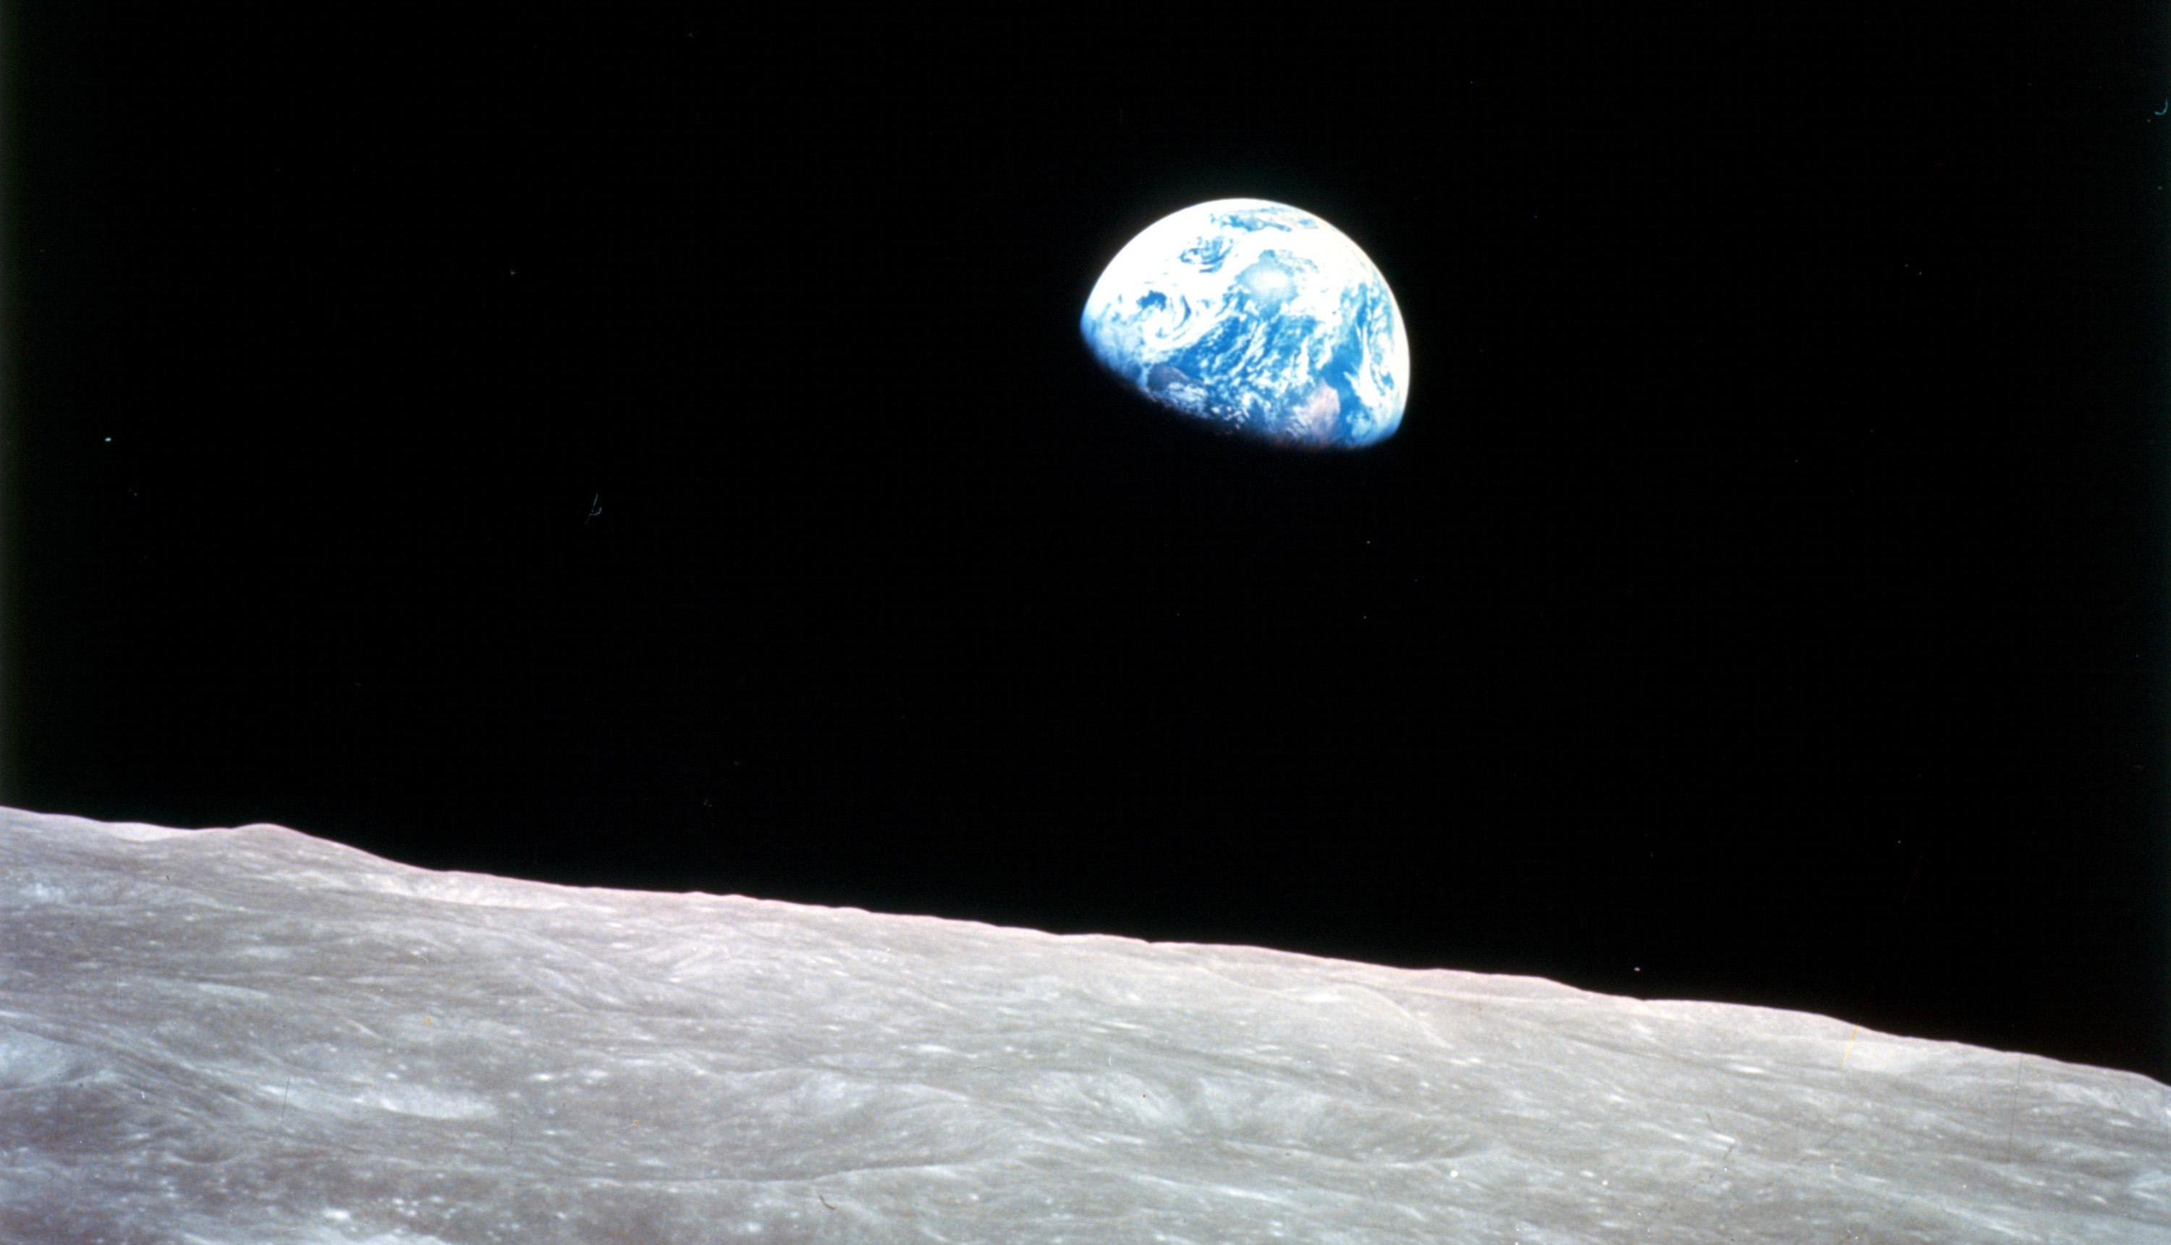
Oh, my God! Look at that picture over there! Here's the Earth coming up. Wow, is that pretty!
~ Astronaut Bill Anders onboard Apollo 8, December 24, 1968

Slide 3
Agenda
T EM P L A T E D ES I G N 3
Introductions
President’s Charge
Updates
Funding and Budget
Goals for this year

Slide 5
President’s Charge and Committee Purpose
T EM P L A T E D ES I G N 3

Slide 6
/'MK'\
November 7, 2019
Dear Lesley and Garrett,
My understanding is that the sustainability committee has begun to meet again, which is great news. It also seems like an excellent opportunity to revisit the charge of the committee and set some goals for the year.
...
My sense is that in the last couple of years the sustainability committee has done an excellent job of planning and implementing cost-effective projects that improve the sustainability of the college. They have wisely focused on obvious gaps, achievable goals, and ease of implementation. The committee has also made good use of the building and renovation plans of the college to look for opportunities to improve the sustainability of our facilities as we accomplish other work.
There has been less progress made on articulating long-tenn goals, a Climate Action and Sustainability Plan, and the development and consistent use of metrics that can be used to assess our progress toward long term goals. My request is that this year that Sustainability Committee focus on creating a long-term plan for the college that:
specifies aspirational and achievable goals for decreased greenhouse gas emission and decreased carbon footprint;
provides a 5-year plan which lays out the steps in a year by year fashion by which goals will be met;
identifies metrics that will align with the goals, which will be monitored and verified on a regular basis as a way of ascertaining progress toward goals;
collaborates with the Facilities Planning Committee (FPC) and appropriate staff to identify the costs and needed resources for meeting the aspirations and goals of the long-tenn plan;
considers the costs and benefits of using an external agency like AASHE STARS or Second Nature as a
reporting mechanism.
Dr. Lara Tiedens
President
W.M. Keck Presidential Chair

Slide 7
Updates and Current Projects
T EM P L A T E D ES I G N 3

Slide 8
Campus Engagement
Met with SAS student representatives
Met with counterparts at CMC and Pomona
2021 Olive Harvest
Upcoming presentation to senior staff
Notes:
The SAS student president and sustainability representative reached out to us to schedule a meeting. There is strong student interest in sustainability this year – 11 students formed a sustainability committee and are working on several different topics of interest: composting/waste diversion, the carbon commitment, divestment, Scripps Scrapps and a proposal for a Free Room.
November 5, 8am-12pm
Registration for contact tracing
Open to 5Cs and local community
In 2019, we harvested 1,500 lbs.
Award winning: Los Angeles International Extra Virgin Olive Oil Competition.

Slide 9
Emissions Tracking
Greenhouse Gas Inventory – data collection in progress
Melrok meters running
Hired student Sustainability Assistant
Opportunity to meet demand for green career skills by offering more sustainability-related student positions
Opportunity to engage students via academic integration
Notes:
Both Pomona and CMC have students working as EcoReps in the residential halls during the school year. Year-round, Pomona has a student dedicated to data collection and reporting (6 hr/week). In the summer, they hire students to help put together the final sustainability report each year.
Build connections with local organizations to explore partnership opportunities and contribute to local community
My prior experience with SEI Climate Corps program and youth leadership/mentorship can inform green career programming
A faculty member has expressed interest in integrating the data analysis component of greenhouse gas reporting into their Fall 2022 class

Slide 10
Sustainability Initiative Fund
T EM P L A T E D EI S G N 3
Current use:
Fund two student garden workers
Fund Sustainability Assistant
Second Nature and AASHE membership

Slide 11
Other Funding Ideas
Dedicated funding for student positions
Green Revolving Fund
Interest from Business Affairs leadership

Slide 12
NEXT STEPS
T EM P L A T E D EI S G N 3
Schedule next meeting
Idea Harvest
Spark conversation with your peers about sustainability
We want to get a "pulse" on what topics are significant to your peers
Send 2-3 ideas to Lauren for next meeting (Can be goals or just loose ideas, short or long term)
Notes:
Ideas on what your "constituents" would like to see happen on campus. In two weeks let Lauren know (can be very loose ideas, even just broad topic areas of something achievable within a year). What do you see us putting funding towards?

Slide 13
Thoughts & Questions
T EM P L A T E D EI G N 3

